Slide 1
UNIT-5 BOUNDARY SCAN STANDARD
P.RAJESH
DEPT OF ECE
JNTUACEA

Slide 2
INTRO…
“Circuitry that may be built into an integrated circuit to assist in the test, maintenance, and support of assembled printed circuit boards . . . includes a standard interface through which instructions and test data are communicated. A set of test features is defined, incluing a boundary-scan register, such that the component is able to respond to a minimum set of instructions designed to assist with testing of assembled printed circuit boards.” — Test Technology Standards Committee of the IEEE Computer Society, in “IEEE Standard Test Access Port and Boundary-Scan Architecture”

Slide 3
the in-circuit testing (ICT) method appeared, in which printed circuit boards (PCBs) are tested by probing the backs of the boards with nails.
The component technology of that era was dual in-line (DIP) packages, which were attached to a PCB by drilling two rows of holes, inserting the DIP into the holes, and wave soldering the leads to the hole (or via), which was plated on the inside with metal.
This testing mechanism relies on nails in a bed-of-nails tester.
The nails are positioned to hit various solder bumps on the back of the PCB and they force various signal values on the component inputs, and measure the component output signals at various other solder bumps.
This very significant testing development, however, was only partially automated, and still relied extensively on adhoc testability insertion.

Slide 4
Boundary scan is actually a collection of design rules, applied at the IC level, but benefiting the testing at all of the above-mentioned system packaging levels.
The port can even be used in functional operation modes of electronics to read out internal status information that has nothing to do with testing.
Parker states that at present, a majority of programmable devices and custom ICs use the 1149.1 standard

Slide 5
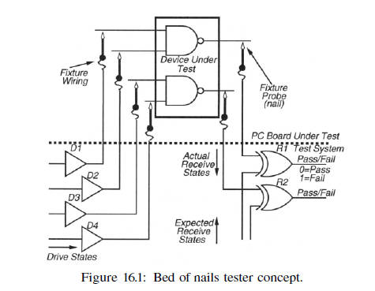
Motivation

Slide 6
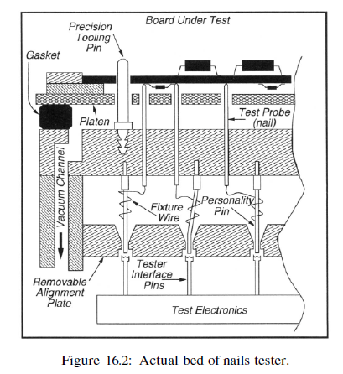
the concept of the tester, shows an actual tester. The divide-and-conquer strategy of the bed-of-nails tester lets us test components in the circuit as if they were actually standing alone.

Slide 7
Purpose of Standard
Boundary scan provides the following major modes of operation:
• In non-invasive mode, the standard provides resources guaranteed to be independent of the rest of the logic (called the system logic) in the IC [511].
These resources enable asynchronous communication with the outside world to serially read in test data and instructions or serially read out test results. The activities are invisible to the normal IC behavior.
• The pin-permission modes of the standard take control of the IC input/output pins, thus disconnecting the system logic from the outside world. These modes allow testing of the system interconnect separately from component testing, and also allow testing of components separately from system interconnect testing.
The testing activities totally disrupt the normal IC behavior.

Slide 8
System Configuration with Boundary Scan
Each pin of the chip, there is internal hardware that provides a register at that pin position. The serial connection of these registers around the periphery of the chip at the pins is known as the boundary register. Input pins can drive the internal system circuit through this internal pin hardware, or the boundary register cell for the particular input pin can be loaded by serially shifting a pattern into the boundary register, and the value at that pin can be used to drive the system circuitry. Similarly, the output of the system circuitry can directly drive an output pin, or the output of the system circuitry can be caught in the boundary register cell for that pin, and then serially shifted out of the chip.
The TDI pin is the serial input to the boundary register, and the TDO pin is the serial output from the boundary register.
Between TDI and TDO, a number of registers provided by the boundary scan hardware can be connected, depending on the current mode of the test hardware.

Slide 9
TAP Controller and Port
Several boundary scan data registers, including the boundary register, the Device ID register, and the bypass register, can be connected serially between TDI and TDO.
Also, the instruction register can be connected serially between TDI and TDO.
The Device ID register provides the device identification.
The bypass register bypasses the boundary register for this component.
This is useful when all boundary registers of all components on the PCB are chained together into one long shift register, and it is desired to reduce the length of the register by ignoring hardware on components that are not involved in the current test.
The instruction register can be loaded with an instruction, which enables various different operation modes of the test hardware.
Several instruction modes are mandatory, others are optional, and user defined instructions can be added, subject to the constraints of the JTAG standard.
The TCK pin provides the test clock for the boundary scan hardware, and must be capable of operating at an independent clock rate from the system clock rate, asynchronously from the system circuitry.
The TMS pin provides the test mode select signal, which causes the testing hardware to enter various testing modes.
Finally, the optional TRST* signal provides an asynchronous reset capability for the boundary scan hardware. The TDI, TDO, TCK, TMS, and TRST* pins form the Test Access Port (TAP), and may not be shared with any other system function.

Slide 10
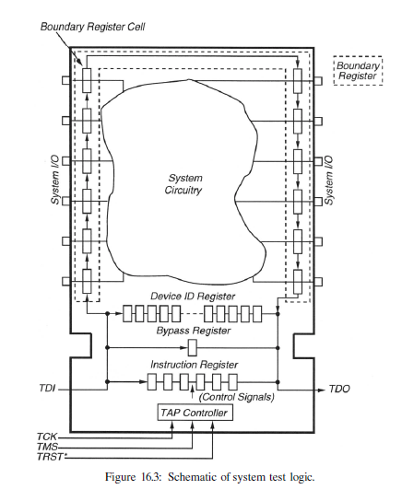

Slide 11
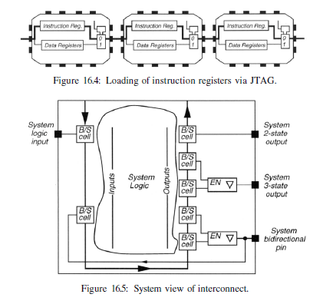

Slide 12
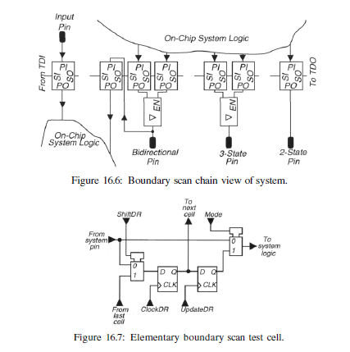

Slide 13
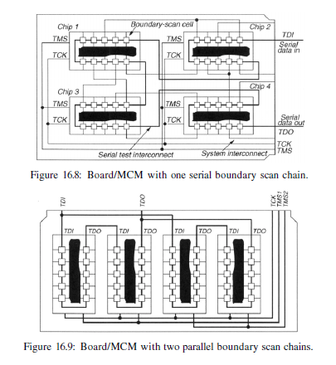

Slide 14
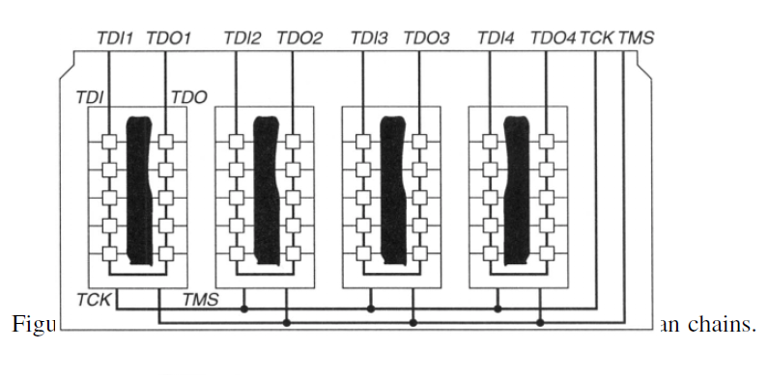
Boundary Scan Test Instructions
The various JTAG TAP Controller test instructions.
Note that the IDCODE and USERCODE instructions, as well as some of the other instructions, can be useful in normal system mode operation, and not just in test.

Slide 15
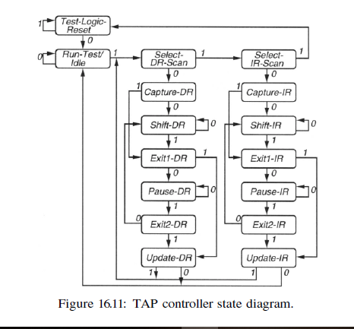
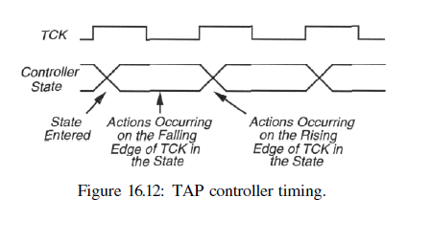

Slide 16
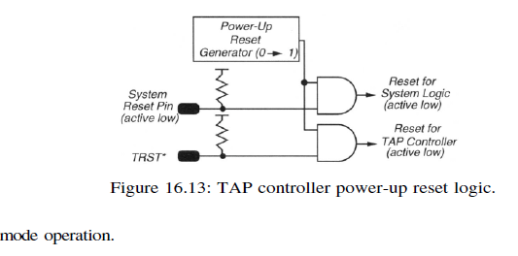
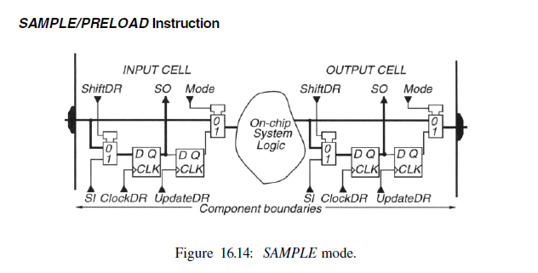

Slide 17
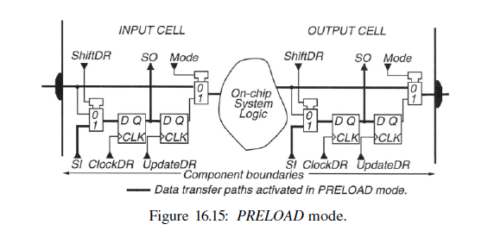

Slide 18
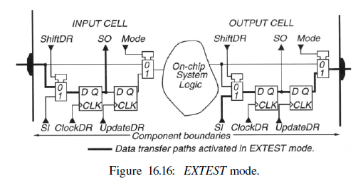
I) EXTEST Instruction

Slide 19
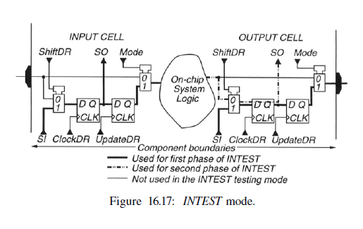
II) INTEST Instruction

Slide 20
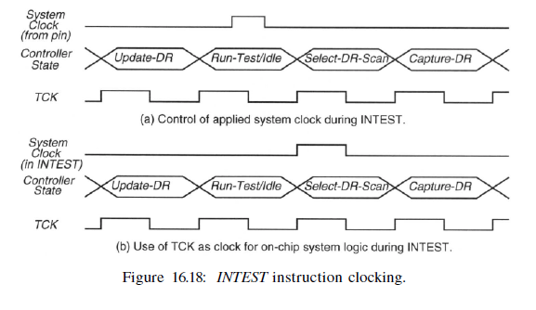

Slide 21
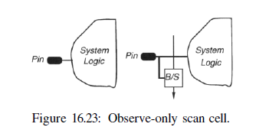
Pin Constraints of the Standard
the JTAG standard allows observe-only scan cells in the boundary scan register. Figure 16.23 shows such a cell, in which the hold register, the data path from the hold register through the MUX closest to the onchip system logic, and the MUX itself have been deleted. This type of cell can only sample the signal coming into the chip pin, but it cannot control the signal going into the on-chip system logic. Contrast this with the normal control-and-observe scan cell.

Slide 22
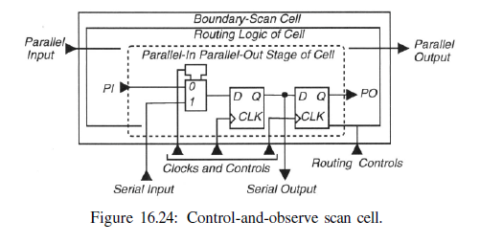

Slide 23
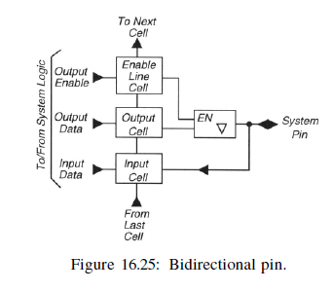
Bidirectional Pins
Figure below shows the required treatment of bi-directional pins under the JTAG standard. One bi-directional pin requires three boundary scan cells in the boundary scan register, one to read the pin in input mode, one to drive the pin in output mode, and a third to drive the pin enable signal, which determines whether the pin is driven by the output boundary scan cell or left in the high-impedance state.

Slide 24
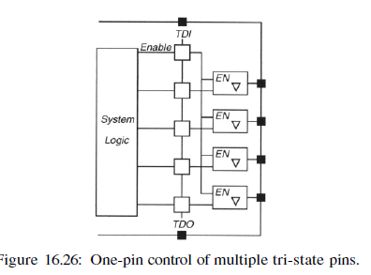
One-Pin Control of Multiple Tri-State Pins
Since large numbers of bi-directional pins consume huge numbers of boundary scan cells, the JTAG standard allows one boundary scan enable cell to control multiple output drive enable signals for multiple pins.

Slide 25
Boundary Scan Description Language
The Boundary Scan Description Language (BSDL) [318] was added to the JTAG Boundary Scan Standard to provide a standard means of communicating information about the boundary scan hardware on a chip to users of the chip and to CAD tools through the VHDL hardware description language. BSDL facilitates communication of information describing test logic in parts between companies and CAD tools. BSDL can be used by automatic test-pattern generators to generate chip test patterns, and by high-level and logic synthesis tools to synthesize test logic.
BSDL is not usable as a simulation model, since it cannot describe voltages, currents, or timing. It is implemented as a subset of VHDL, but may need modification for certain VHDL tools.

Slide 26
In the Boundary Scan Description Language (BSDL), one can describe the length and structure of boundary scan registers and the availability of the optional TRST* (TAP Controller reset) pin. Also, the physical locations of TAP pins, the available JTAG instruction codes on this chip, and the device identification code can be described.
However, the TAP Controller state diagram cannot be described (that must be the standard one.) Also, the bypass register cannot be described, as it is always present and always one bit long.
The length of the device identification register cannot be described, because that is set by the JEDEC standard.
The SAMPLE/PRELOAD, BYPASS, and EXTEST instructions cannot be described, since these are always present.
Finally, the operation of user-defined instructions cannot be described.

Slide 27
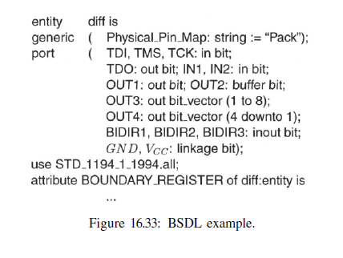
BSDL Description Components

Slide 28
Pin Descriptions
The following standard USE statement is always required:
use STD_1149_l_1994.all;
These boundary scan pin types are available:
• in (input-only)
• out (may be tri-state or open-collector)
• buffer (active, two-state, and always driven)
• inout (bi-directional)
• linkage (power, ground, analog, or non-connected pins)

Slide 29
Boundary scan register cells have these types:
• INPUT – control and observe, or observe-only cell.
• CLOCK – cell at a clock input.
• OUTPUT2 – drives a two-state output.
• OUTPUT3 – drives a tri-state output.
• CONTROL – controls a tri-state output.
• CONTROLR – disabled in Test-Logic-Reset TAP Controller state.
• INTERNAL – not associated with a digital pin.
• BIDIR – reversible cell of a bidirectional pin.
• OBSERVE_ONLY – a single input observe-only cell.

